Slide 1
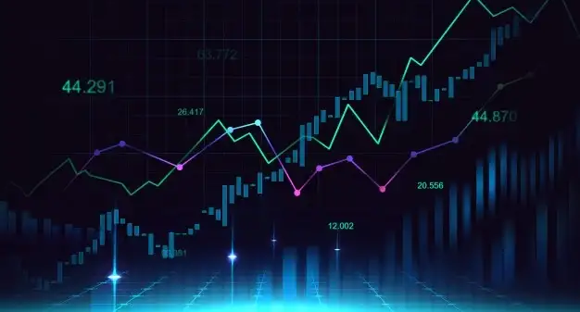

A FRAMEWORK FOR STOCK PRICE FORECASTING USING A LONG SHORT-TERM MEMORY NEURAL NETWORK
João Ramos Graça
November 2022

Slide 2

CONFIRMATION BIAS
People tend to believe what makes them feel good, (or what they want to be true) even when evidence points the other way.
We also like to believe we are smarter than our fellow human.
It takes a good deal of effort to evade this effect.
We all suffer from confirmation bias.
Notes:
Confirmation bias is the cognitive bias that allows us

Slide 3
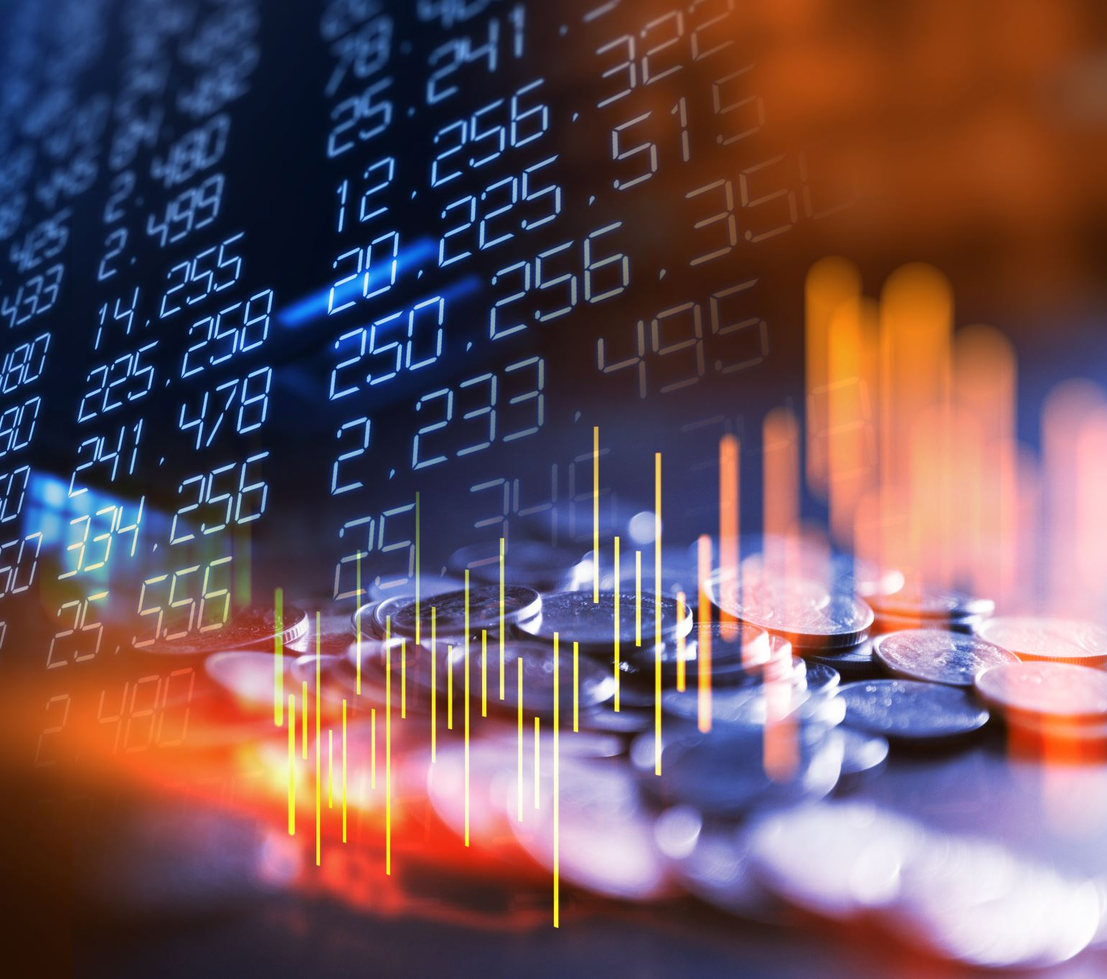
MARKET EFFICIENCY
Is the market efficient?
There are definitely periods of inefficiency and irrationality
Can we take advantage of them?

Slide 4
FUNDAMENTAL ANALYSIS
TECHNICAL ANALYSIS
Takes into account long-term trends
Analysis of the operational side of the business
Evaluation of markets, demand, competition, etc.
Analysis of intrinsic value
Potential for future growth
Essentially long-term
Assumes market is efficient
All information contained in prices
Analysis of trading patterns
Use of indicators and signals to
Mostly short-term

Slide 5



TECHNOLOGY
STACK

Slide 6
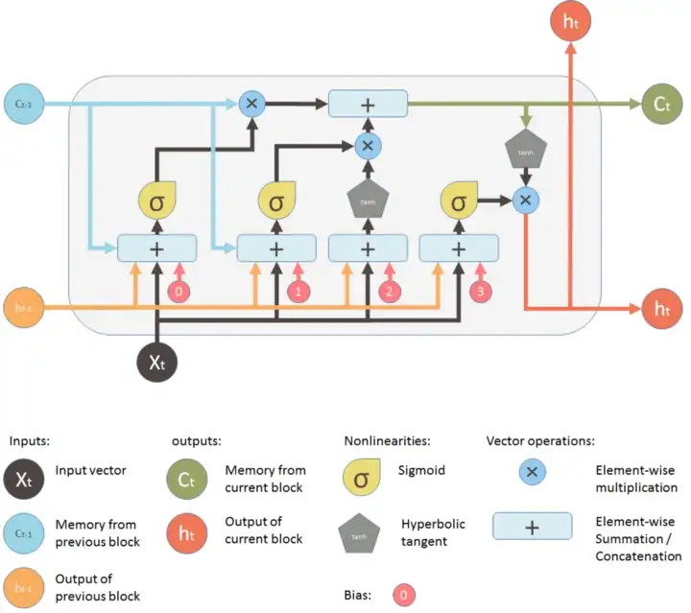
LSTM NEURAL NETWORKS

Slide 7

LSTM NEURAL NETWORKS
They have the ability to figure out connections between data with long-term dependencies
This makes them ideally suited to analyse sequential data, so they are used for things like Natural Language Processing and time series (such as stock prices).
Avoids the vanishing gradient problem

Slide 8

RESULTS
Unfortunately, I can’t say it was a success.
LSTM Neural Networks not only take a long time to train, but also need to be trained several times to fine tune the hyperparameters.
For that reason, the initial intention of training in all S&P 500 stocks had to be cut down dramatically.
We limited ourselves to the 25 most traded stocks. Since two of those were different classes of Alphabet/Google stock, we trained 24 models.
In quite a few of the models, the training data is considerably different from the test data.
From the 24 time series trained, only three had somewhat satisfactory results.

Slide 9
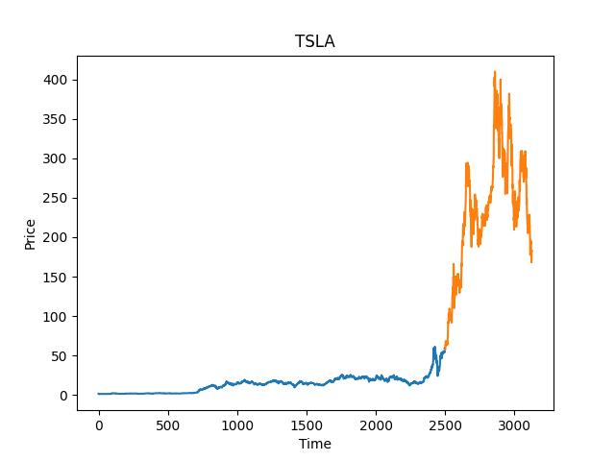
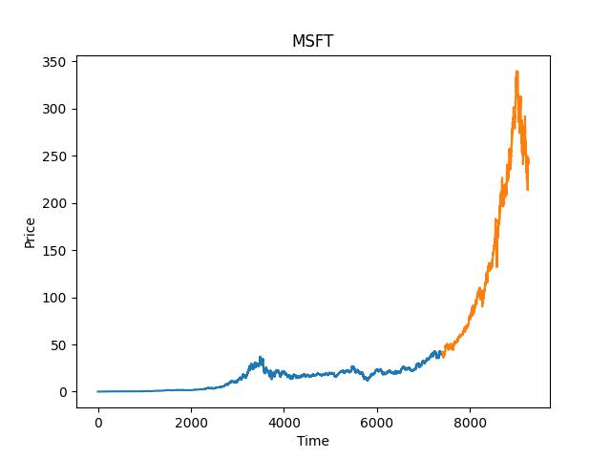
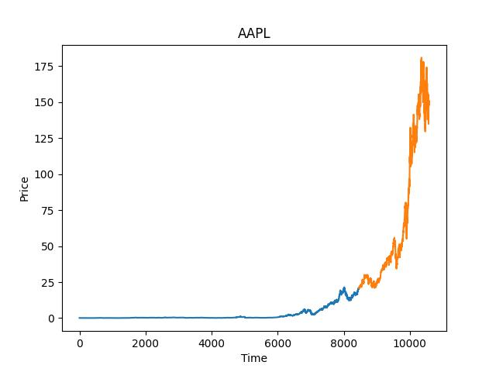

Slide 10
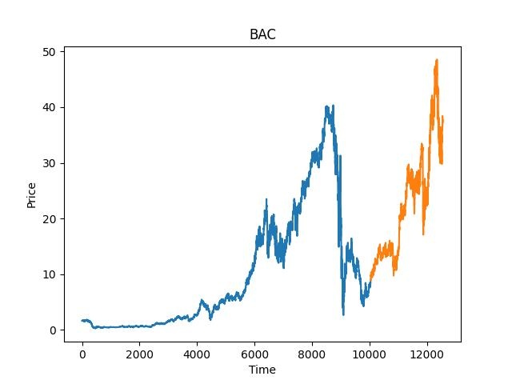
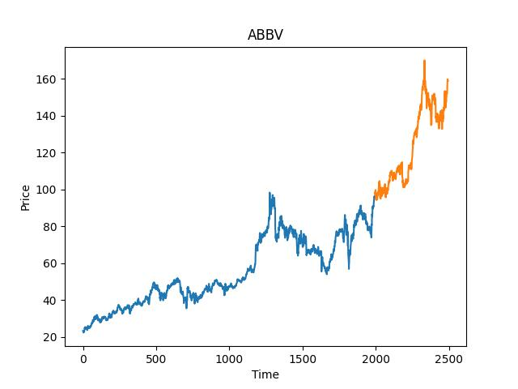

Slide 11

STOCK BOT 2000
Uses the neural network to predict the daily stock price
Can be used to manage your portfolio
Can generate graphs

Slide 12

FUTURE STEPS
Train better models
Integrate predictions in portfolio
Make a more integrated product

Slide 13
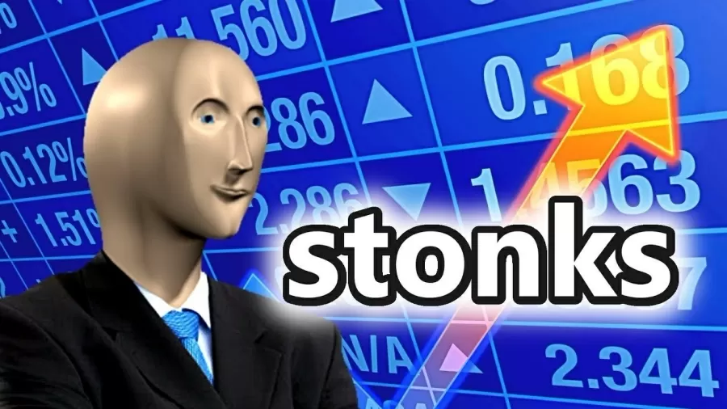

Slide 14

QUESTIONS?

